Slide 1
Safety Graphics: Cross-industry Collaboration to Improve Patient Safety using Open-Source Tools
Links: CRAN | GitHub | Demo

Slide 2
Agenda
The Need: Superior Safety Monitoring Tools
The Team: ISG Working Group
The Product: safetyGraphics R Package

Slide 3
Agenda
The Need: Superior Safety Monitoring Tools
The Team: ISG Working Group
The Product: safetyGraphics R Package

Slide 4

The Demands of Ensuring Patient Safety
Novartis COVID-19 DMC¹
Fast Recruitment and Frequent Safety Reviews
Virtually no prior experience with disease
Sarepta Essence Study
Rare disease requiring intensive safety monitoring
Over 27,000 pages of paper listings
1. https://www.ncbi.nlm.nih.gov/pmc/articles/PMC7833551/

Slide 5
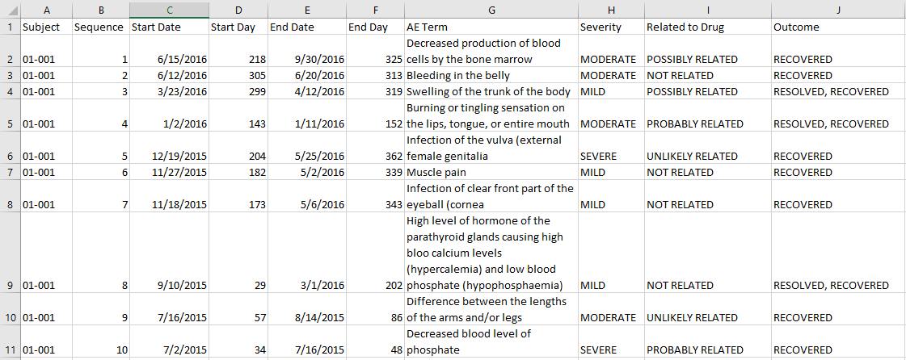
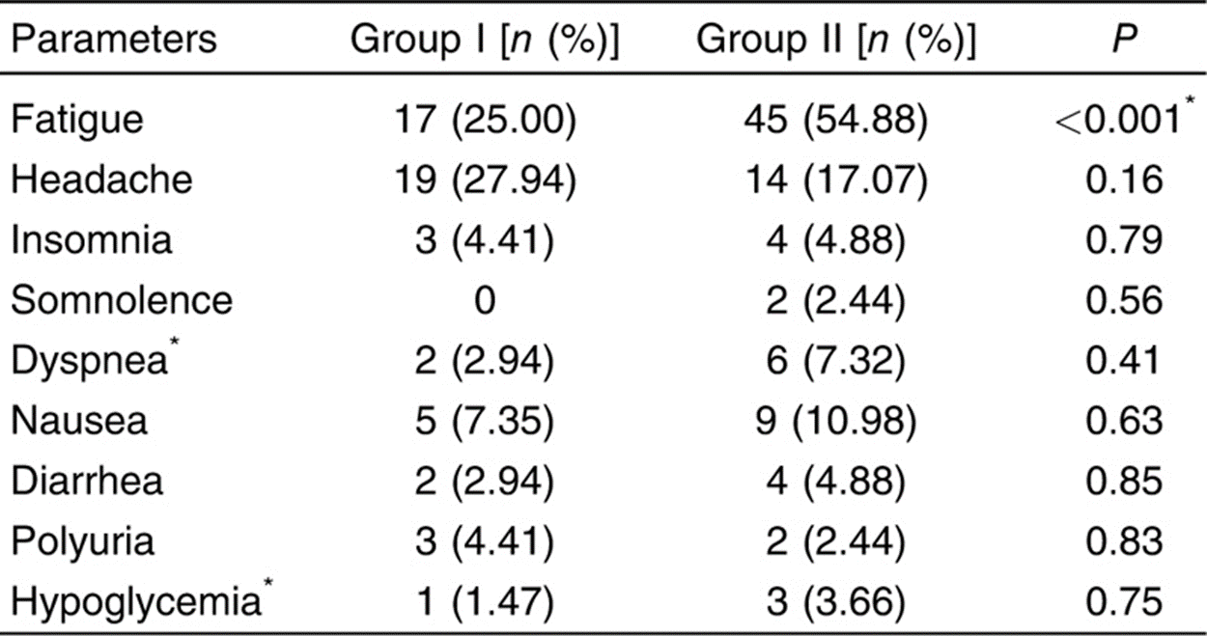
Typical Tools: Static Tables and Listings
Disclaimer: this listing is populated with dummy public data

Slide 6
Typical Tools: Proprietary Solutions
Expensive
Difficult to extend or customize
Lifespan, updates, support all tied to vendor

Slide 7
Agenda
The Need: Superior Safety Monitoring Tools
The Team: ISG Working Group
The Product: safetyGraphics R Package

Slide 8



Interactive Safety Graphics (ISG) Working Group
https://safetygraphics.github.io/
Sub-team of DIA & ASA-Biopharm Safety Working Group
Notes:
Public-Private Partnership (PPP)

Slide 9




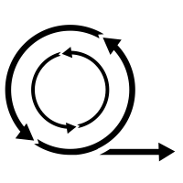


ISG Guiding Principles
Open Source
Highly Collaborative
Interactive
Easy to use
Data Standard Compliant
Agile
Engaging

Slide 10
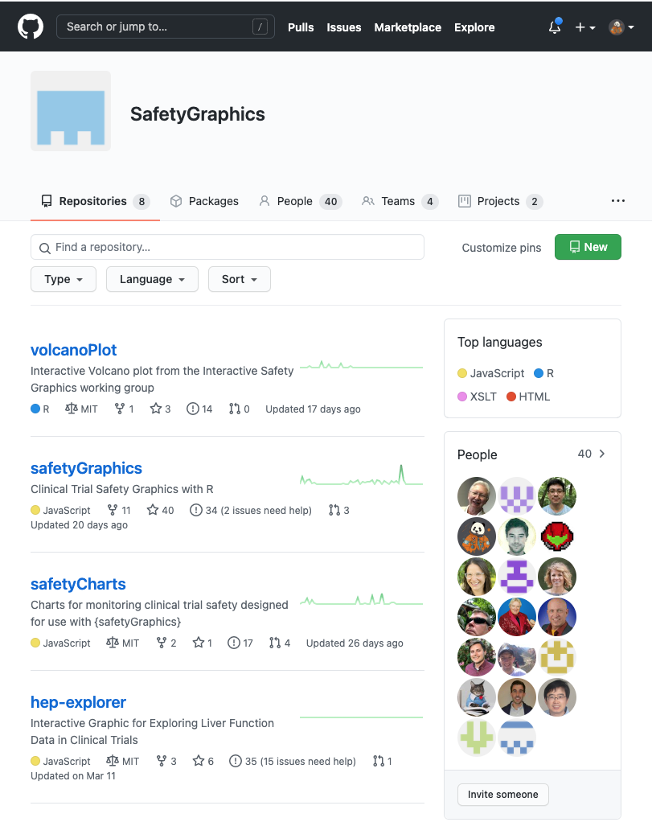
Open and Transparent Online Collaboration
We use a public GitHub site for:
Source Code Storage
Version Control
Testing/QC infrastructure
Issue tracking
Release Tracking
Discussion boards
Meeting Minutes
Project Management (Kanban boards, etc.)
Web-site hosting
Continuous Integration
https://github.com/SafetyGraphics

Slide 11
Agenda
The Need: Superior Safety Monitoring Tools
The Team: ISG Working Group
The Product: safetyGraphics R Package

Slide 12
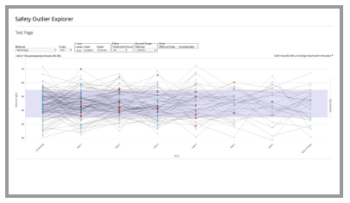
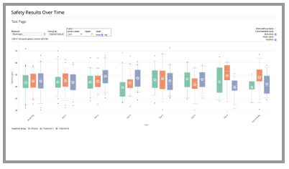

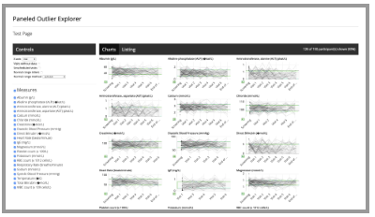
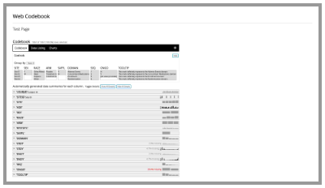
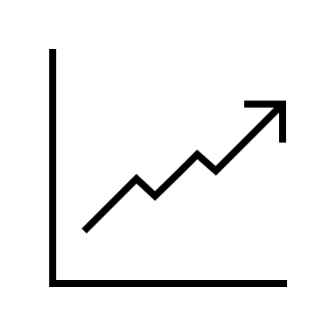


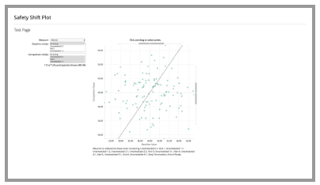
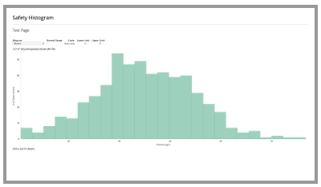


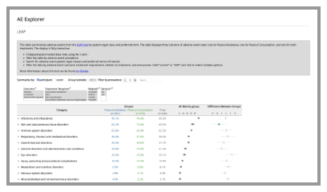
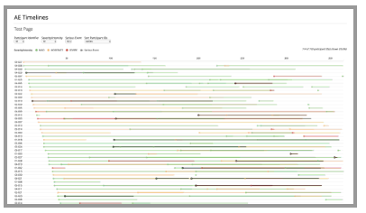



SafetyGraphics Components
Domain Data
Interactive Graphics
Charts
Metadata + Mapping

Slide 13
{safetyGraphics} v1.0 - Lessons Learned
Use R For Data Load/Config
Shared Data and Settings
Flexible data standards
Modular Shiny Framework
Exported HTML Reports
Updates Needed
What Worked
Expand Data Domains
Support more than HTML Widgets
Add New Charts
Develop new workflows
Extend Testing
- Enable Saving of mappings

Slide 14
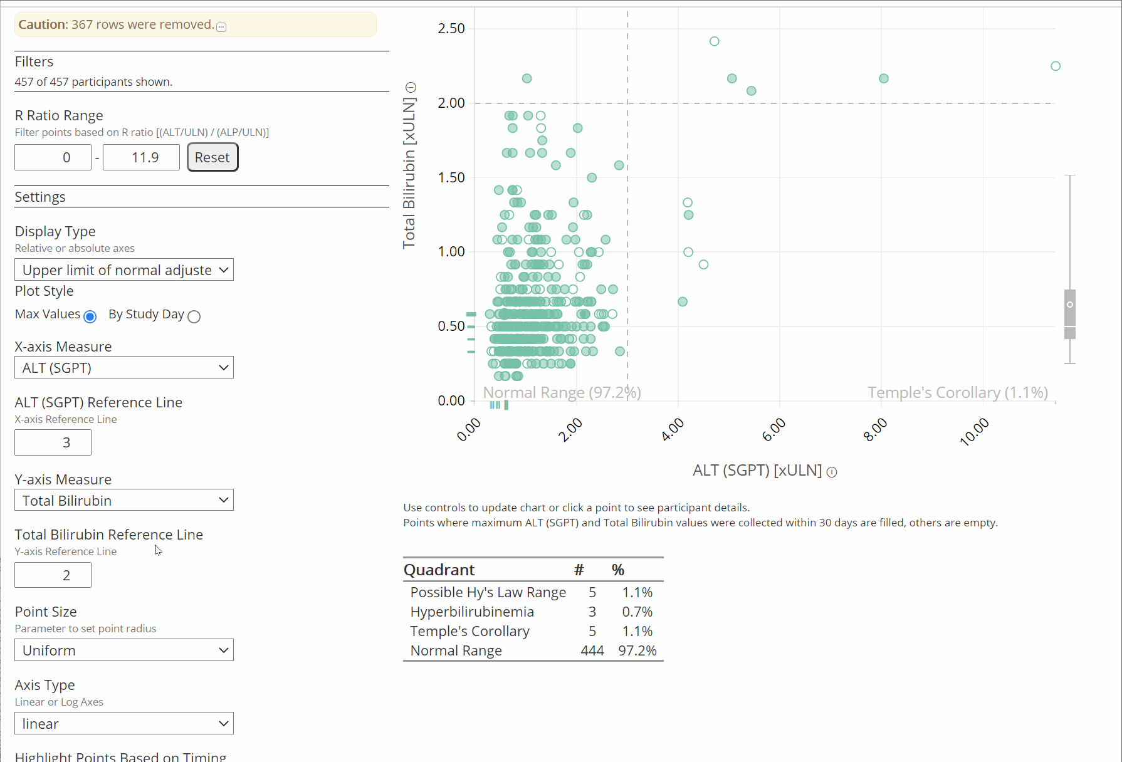
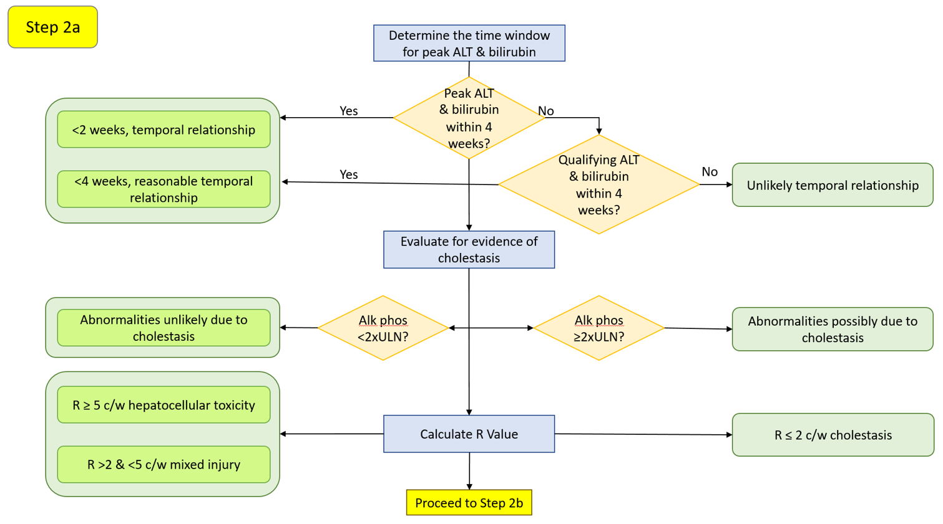
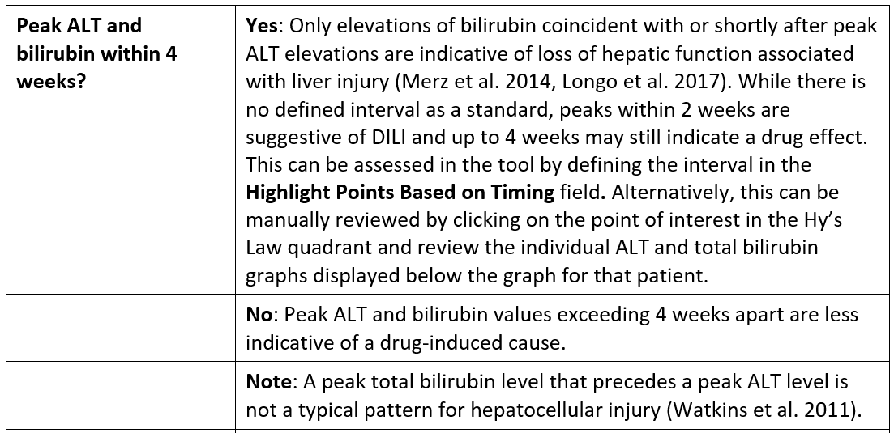
Charts + Workflows: Hepatic Explorer

Slide 15
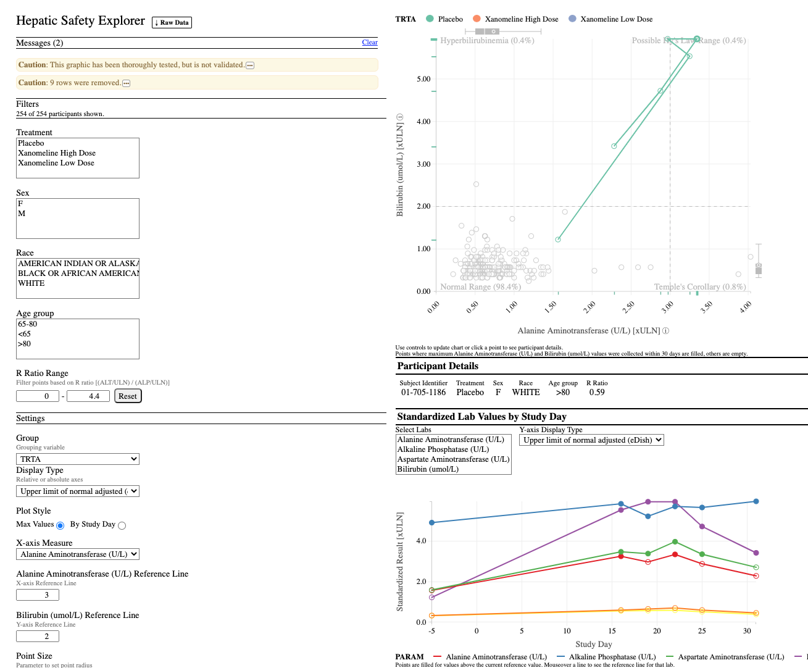
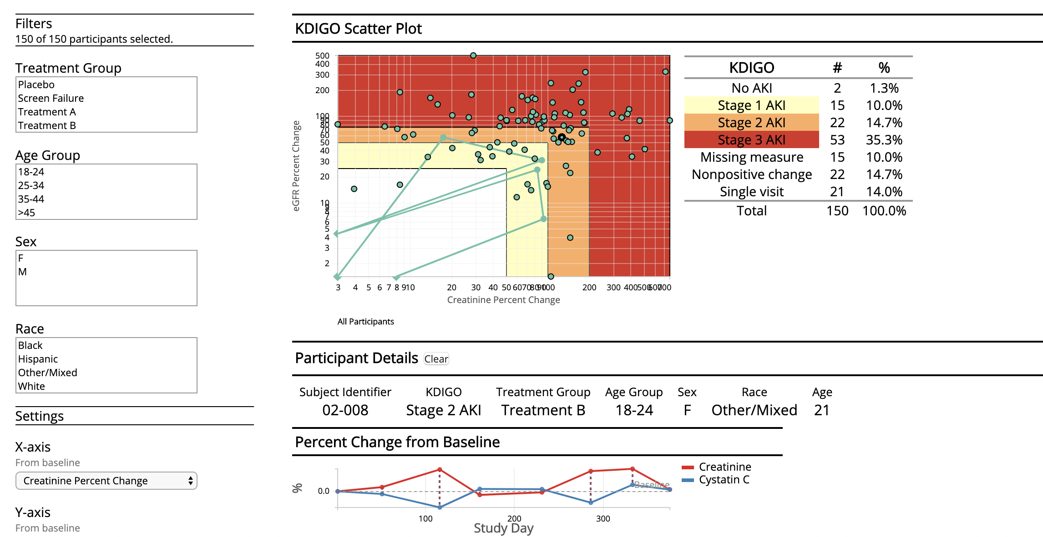
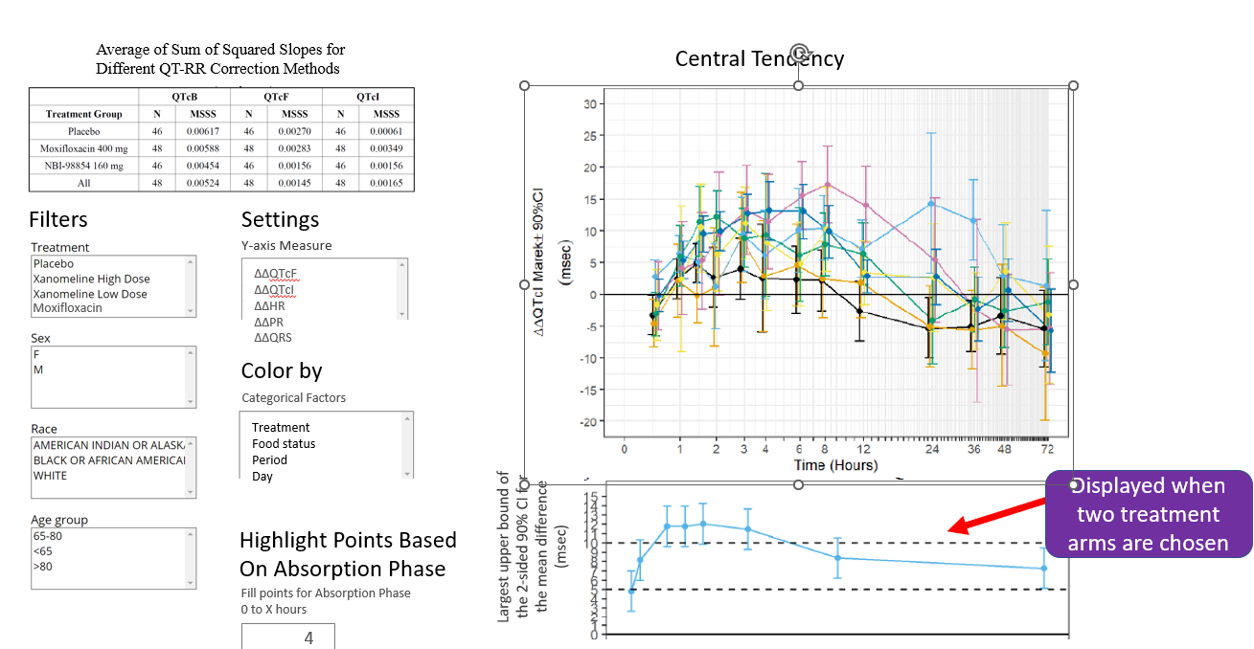
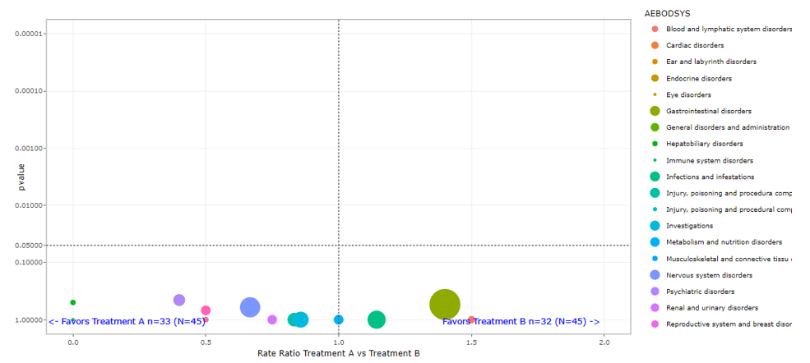
Current Workstreams
Hepatic Explorer
Renal Explorer
QT Explorer
AE Volcano plot

Slide 16
Acknowledgements
ASA/DIA Safety Working Group
Interactive Safety Graphics WG
https://safetygraphics.github.io/
http://safetygraphics.org
Jeremy Wildfire - Xiao Ni
James Buchanan - Mengchun Li
Open-source community

Slide 17
Want to get involved?
Fill out this form!
(or send me an email at PrBurns@Sarepta.com)

Slide 18
Safety Graphics Demo
Notes:
If time??

